Slide 1
CSTE 2201: Object Oriented Programming with JAVA.

Slide 2
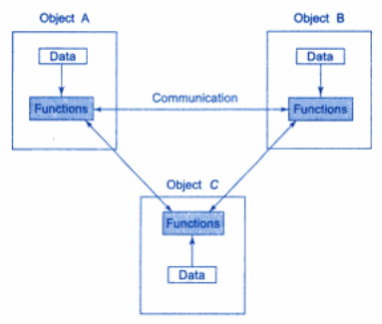
What is Object Oriented Programming?
Object Oriented Programming (OOP) allows decomposition of a problem into a number of entities called objects and then builds data and functions around these objects.

Slide 3
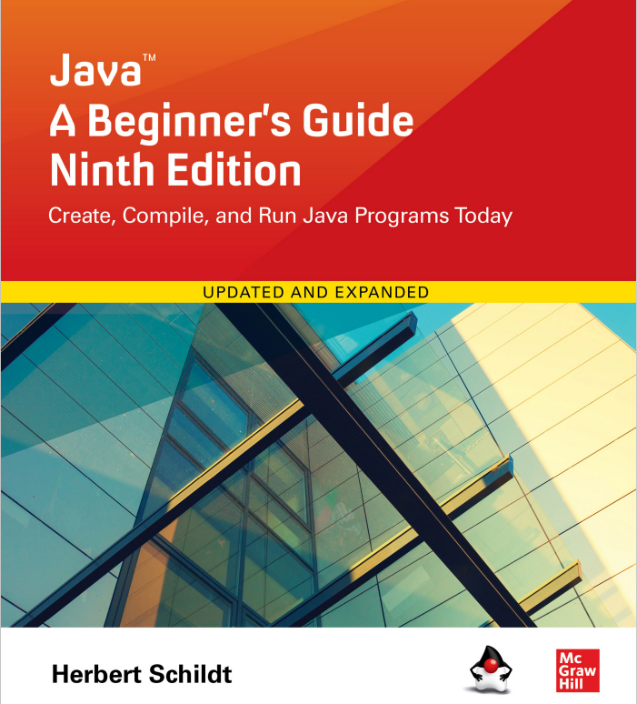
Reference Book:

Slide 4
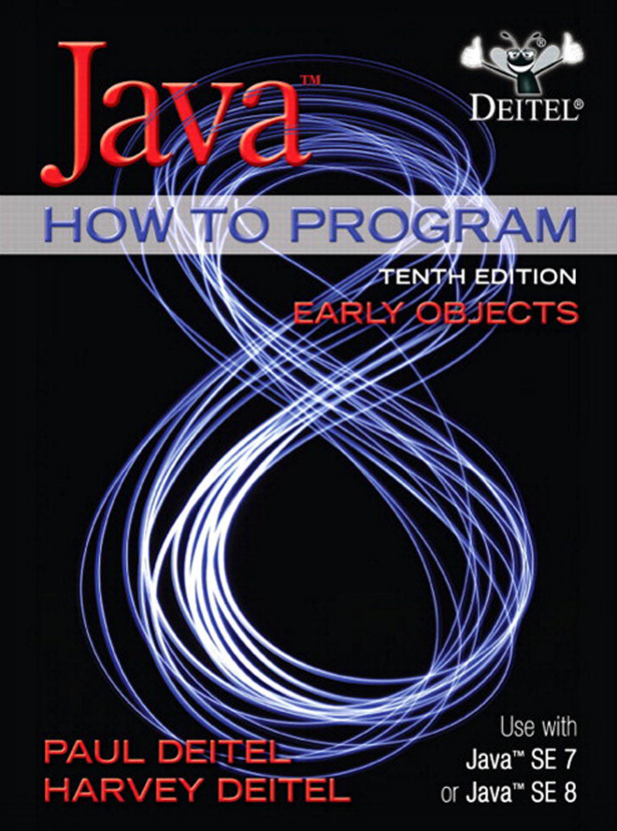
Reference Book:

Slide 5
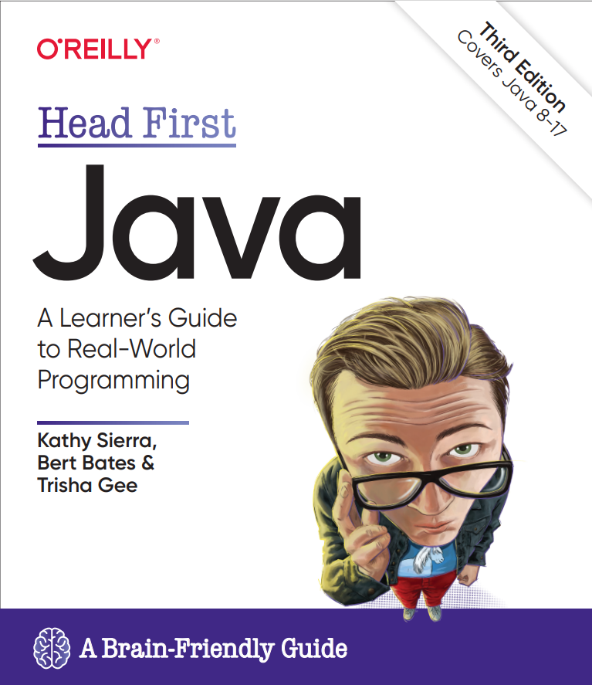
Reference Book:

Slide 6
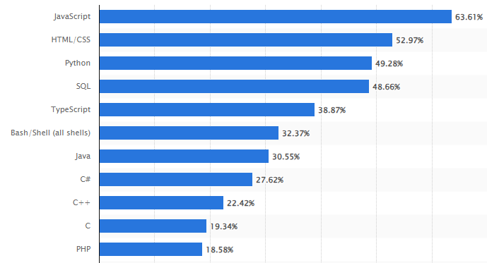
Most used programming languages among developers worldwide as of 2023

Slide 7
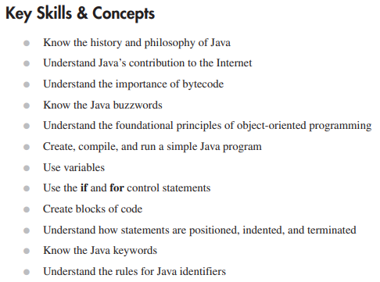
Java Fundamentals

Slide 8
Java Fundamentals
Java was conceived by James Gosling, Patrick, Chris, Frank and Mike Sheridan at Sun Microsystems in 1991.
The origin impetus for Java was not the Internet!
Instead, the primary motivation was the need for a platform-independent language that could be used to create software to be embedded in various consumer electronic devices, such as toasters, microwave oven and remote controls.

Slide 9
Java Fundamentals
Gosling et al. worked on a portable, cross-platform language that could produce code that would run on variety of CPUs under differing environments.
This effort ultimately led to the creation of Java!
With advent of the Internet and the Web, the old problem of portability returned with a vengeance.
After all, the Internet consisted of a diverse, distributed universe populated with many types of computers, operating systems and CPUs.

Slide 10
Java Fundamentals
What was once an irritating but low-priority problem had become a high profile necessity.
By 1993 it become obvious to members of the Java design team that the problems of portability frequently encountered when creating the code of embedded controllers are also found when attempting to create code for the Internet.
This realization caused the focus of Java to switch from consumer electronics to Internet Programming.

Slide 11
Java Fundamentals
So, although it was the desire for an architecture-neutral programming language that provided the initial spark, it was the ultimately led to Java’s large-scale success.

Slide 12
Java Fundamentals
Java’s Lineage: C and C++
From C, Java inherits its syntax.
Java’s object model is adapted from C++.
Java’s relationship to C and C++ is important for many reasons.
First, at the time of Java’s creation, many programmers were familiar with C and C++ syntax.

Slide 13
Java Fundamentals
How Java Impacted the Internet:
Java had a profound impact on the Internet.
First, the creation of Java simplified Internet Programming.
Second, Java innovated a new type of networked program called the applet that changed the way the online world through about content.
Finally, Java addressed some of thorniest issues associated with the Internet: portability and security.

Slide 14
Java Fundamentals
Java Simplified web-based programming:
Java’s ability to create portable, cross-platform programs.
Java support networking program.
Its library of ready-to-use functionality enabled programmers to easily write program that accessed or made use of the Internet.

Slide 15
Java Fundamentals
Java Applets:
At the time of Java’s creation, one of the exciting features was the applet.
An applet is a special kind of Java program that is designed to be transmitted over the Internet and automatically executed inside a Java-compatible web browser.
In early days of Java, applets were a crucial part of Java programming.
JDK 9 began their phase-out process. Finally, applet support was removed by SDK 11.

Slide 16
Java Fundamentals
Security:
A program that downloads and executes on the client computer must be prevented from doing harm.
Java addressed these problems in an effective and elegant way.

Slide 17
Java Fundamentals
Portability:
Portability is a major aspect of the Internet because there are many different types of computers and operating systems connected to it.
Java programs apply a mechanism that allows the same application to be downloaded and executed by wide variety of CPUs, operating system and browser is required.

Slide 18
Java Fundamentals
Java’s Magic: The Bytecode:
Bytecode is highly optimized set of instructions designed to be executed by what is called the Java Virtual Machine (JVM), which is the part of the Java Runtime Environment (JRE).
Translating Java program into bytecode makes it much easier to run a program in a wide variety of environments because only the JRE needs to be implemented for each platform.
Once a JRE exists for a given system, Java program can run on it.

Slide 19
Java Fundamentals
Java’s Magic: The Bytecode:
The original JVM was designed as an interpreter for bytecode.
Although Java was designed as an interpreted languages, there is nothing about Java that prevents on-the-fly compilation of bytecode into native code in order to boost performance.
For this reason, the HotSpot JVM was introduced not long after Java’s initial release.

Slide 20
Java Fundamentals
Java’s Magic: The Bytecode:
HotSpot includes a just-in-time (JIT) compiler for bytecode.
When a JIT compiler is part of the JVM, selected portions of bytecode are compiled into executable code in real time on a piece-by-piece demand basis.
That is, a JIT compiler compiles code as it is needed during execution.

Slide 21
Java Fundamentals
Object Oriented Programming:
At the center of Java is object-oriented programming (OOP).
To support the principles of object-oriented programming, all OOP languages, including Java, have three traits in common: encapsulation, polymorphism, and inheritance.

Slide 22
Java Fundamentals
The Java Development Kit:
It is time to start writing Java programs.
Before you can compile and run those programs, you must have a Java Development Kit (JDK).
The current release of the JDK is JDK 20.
This is the version for Java SE 20. (SE stands for Standard Edition.).
It is recommended that you use JDK 17 (or later) to compile and run the example programs.

Slide 23
Java Fundamentals
The Java Development Kit:
Install the JDK on your computer, be aware that for modern versions of Java, both Oracle JDKs and open source OpenJDKs are available for download.
In general, you should first find the JDK you want to use.
For example, at the time of this writing, the Oracle JDK can be downloaded from www.oracle.com/java/technologies/downloads/

Slide 24
Java Fundamentals
The Java Development Kit:
Open source version is available at jdk.java.net
The JDK supplies two primary programs.
The first is javac, which is the Java compiler.
The second is java, which is the standard Java interpreter and is also referred to as the application launcher.
One other point: The JDK runs in the command-prompt environment and uses command-line tools. It is not a windowed application. It is also not an integrated development environment (IDE).

Slide 25
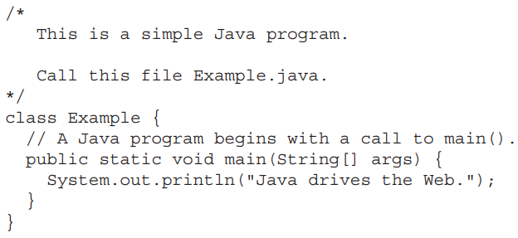
Java Fundamentals
A First Simple Program:
Let’s start by compiling and running the short sample program shown here:

Slide 26
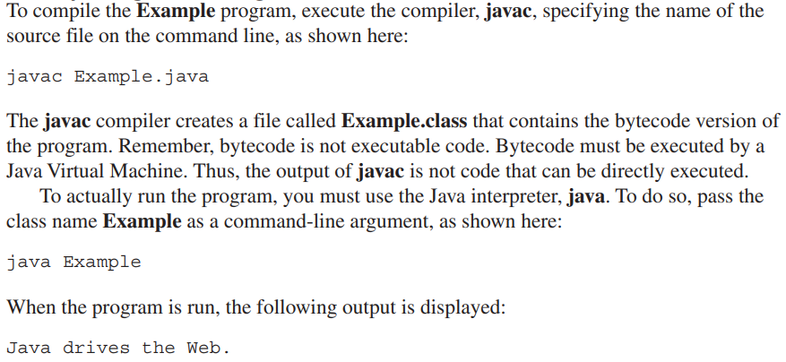
Java Fundamentals
Compiling the Program:

Slide 27
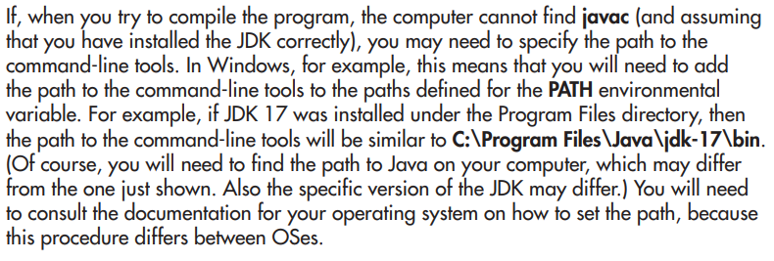
Java Fundamentals
Compiling the Program:

Slide 28
Java Fundamentals
Compiling the Program:

Slide 29
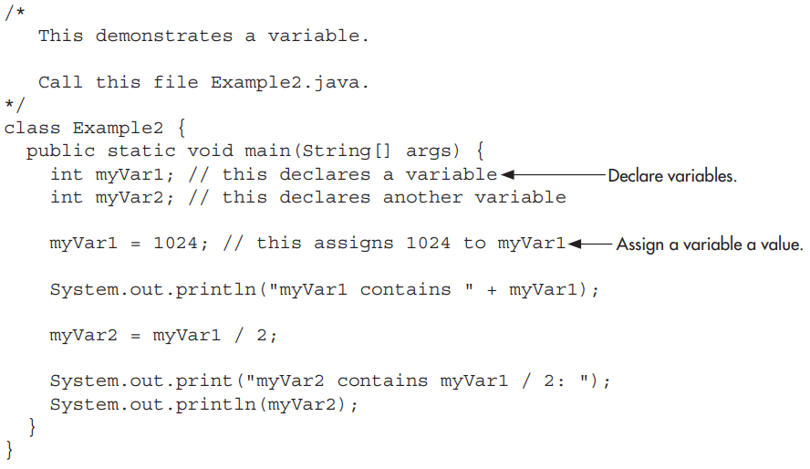
Second Sample Program:

